Slide 1
Ritter energie- & umwelttechnik

Slide 2
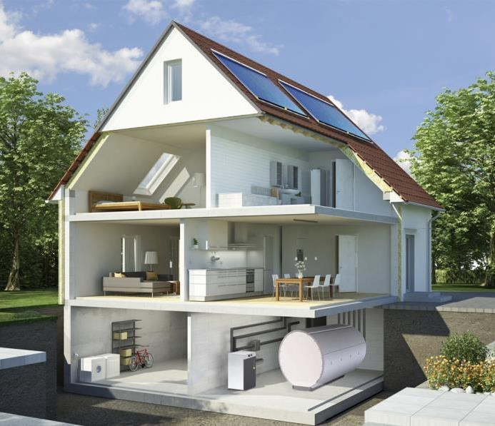
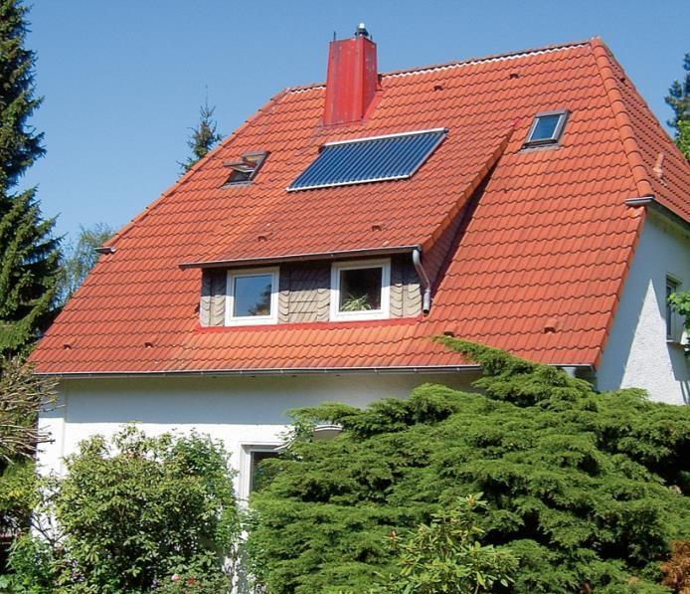
The solar Experts
From small to large
Kleinere Anlage

Slide 3
Business fields
Production of collectors
collector components | R&D
Heating systems for single and multi family houses and apartment buildungs
Large solar plants for heating networks | industry | commerce

Slide 4
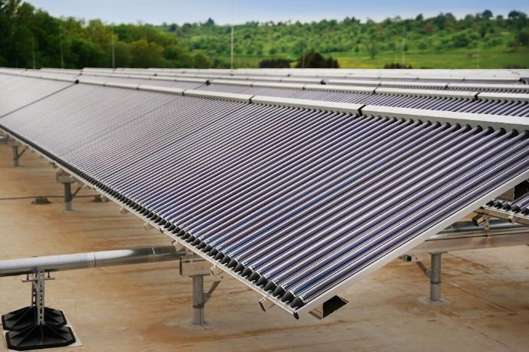
the brand ritter XL solar
The Ritter XL Solar team plans and implements large-scale solar thermal systems at first hand.
These include large residential or office buildings, local and district heating networks or process heating systems for industry and commerce.
The use of solar thermal energy reduces energy costs and improves the ecological balance on a large scale.

Slide 5
Reasons for solar in district heating grids
Space efficiency and emissions Significantly higher space efficiency, fewer emissions and delivery traffic compared to wood, for example
Cost security No imputed risk in terms of price stability compared to fossil fuels in particular
Regional/local added value Production of solar panels and system components in the EU, realization of systems with local specialist tradespeople
Reliable, proven, durable and market-available technology
Solar thermal
Photovoltaic
Maize / rapeseed
Wood chips
factor: 1
factor: 3
factor: 36
factor: 60

Slide 6
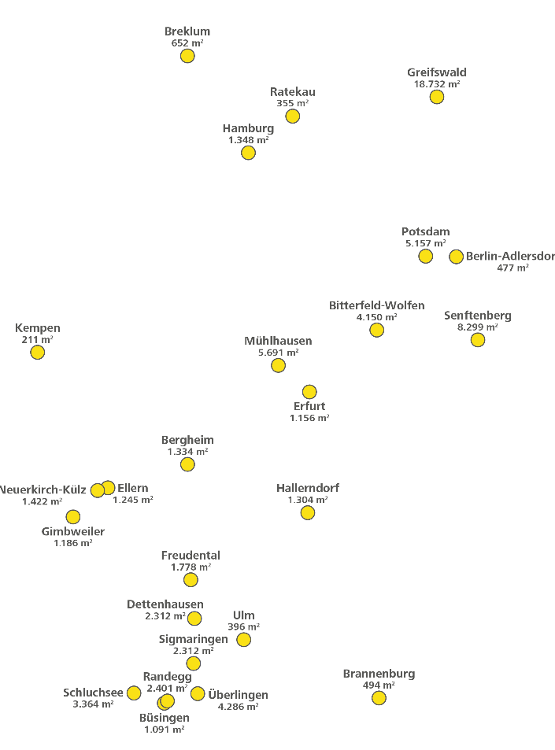
Realized solar thermal plants
Realized solar thermal plants
Solar thermal plants under construction

Slide 7
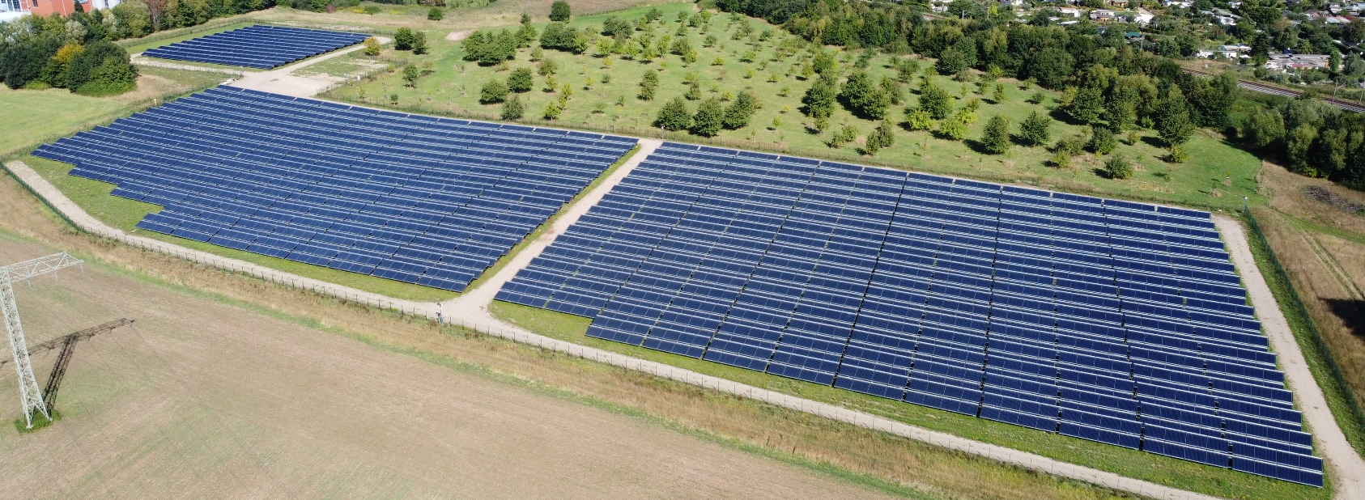
the brand ritter XL solar
18.700 m²
is the area of Germany's largest solar thermal plant in Greifswald. Realized by Ritter XL Solar.
picture: Stadtwerke Greifswald
Ritter XL Solar

Slide 8
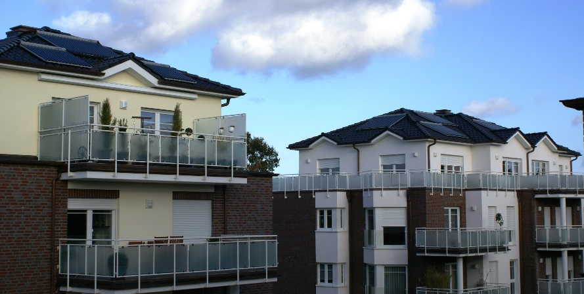
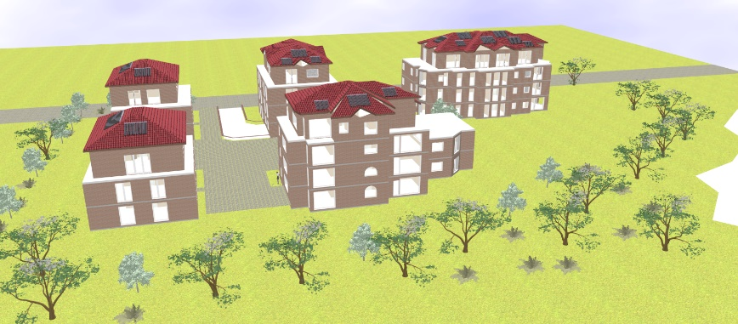
Small living areas
Low temperature heating grid
City of Oldenburg
No of buildings | 5
Heat demand grid | ~175 MWh
Commissioning | 2012
Gross collector area | 100 m² (5 fields)
Annual energy yield | 35 MWh
Solar fraction | 20 %
Nominal power | 50 kW
Heat grid temperatures | 70 / 55 °C
Heat store | 4.0 m³
Feed-in type | Decentralized, surplus heat into grid
picture: Ritter XL

Slide 9
Solar district heating for villages
Community of Neuerkirch-Külz (Hunsrück region)
Inhabitants | 750
Connection rate | 80 %
Commissioning | 2016
Gross collector area | 1,422 m²
Land area | 3,700 m²
Annual energy yield | 625 MWh
Solar fraction | 20 %
Nominal power | 0,9 MW
Heat grid temperatures | 75 / 60 °C | 80 / 55 °C
Length of heating grid | 6 km
picture: ibs Energie

Slide 10
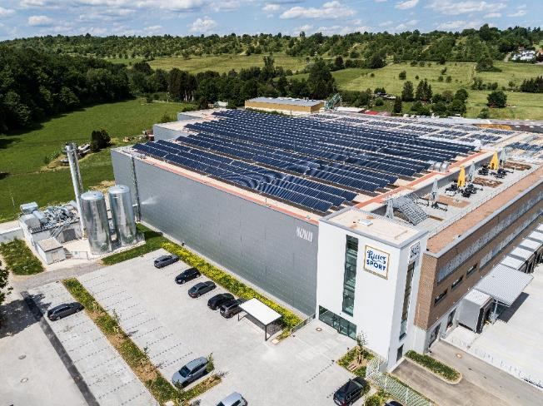
Solar district heating for villages
Germany's largest solar thermal roof plant
Community of Dettenhausen
Inhabitants | ~ 5,530 (2022)
Heat demand grid | 6.2 GWh
Commissioning | 2022
Gross collector area | 2,310 m²
Roof surface | 7,900 m²
Annual energy yield | 1.1 GWh
Solar fraction | 18 %
Nominal power | 1.4 MW
Heat grid temperatures | 80 / 60 °C
Heat store | 200 m³
Feed-in type | Centralized at the CHP
picture: Stadtwerke Tübingen

Slide 11
Solar district heating for cities
Municipal utility
City of Senftenberg
Inhabitants | 25,000
Heat demand grid | 100 GWh
Commissioning | 2017
Gross collector area | 8,300 m²
Land area | 20,000 m²
Annual energy yield | 4 GWh
Solar fraction | 4.0 %
Nominal power | 4.5 MW
Heat grid temperatures | 85 / 65 °C | 105 / 55 °C
picture: Stadtwerke Senftenberg

Slide 12
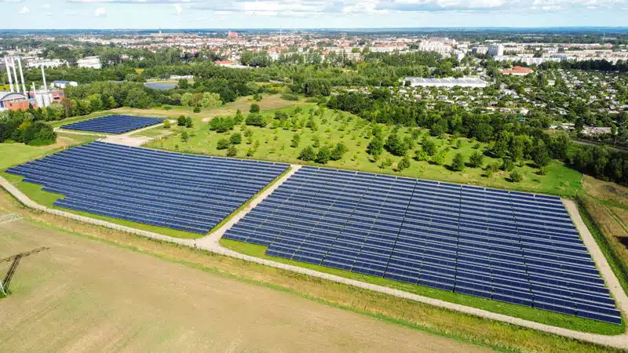
Solar district heating for cities
Municipal utility
City of Greifswald
Inhabitants | 59,300
Heat demand grid | 238 GWh
Commissioning | 2022
Gross collector area | 18,732 m²
Land area | 41,500 m²
Annual energy yield | 8.1 GWh
Solar fraction | 3.4 %
Nominal power | 11.2 MW
Heat grid temperatures | 98 °C / 60 °C
Heat store | 5,400 m³
Feed-in type | Centralized at the heat plant
picture: Stadtwerke Greifswald

Slide 13
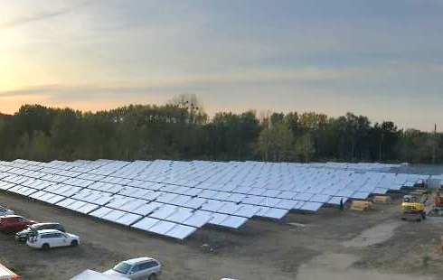
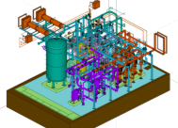
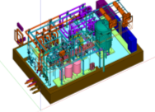
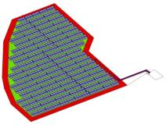
Solar district heating for cities
Municipal utility
City of Potsdam
Inhabitants | ~ 178,000
Heat demand grid | 2,238 GWh
Commissioning | 2019
Gross collector area | 5,160 m²
Land area | ~ 10,000 m²
Annual energy yield | 2.3 GWh
Solar fraction | 0.1 %
Nominal power | 3.1 MW
Heat grid temperatures | 85 / 67 °C | 125 / 60 °C
picture: Planning Ritter XL

Slide 14
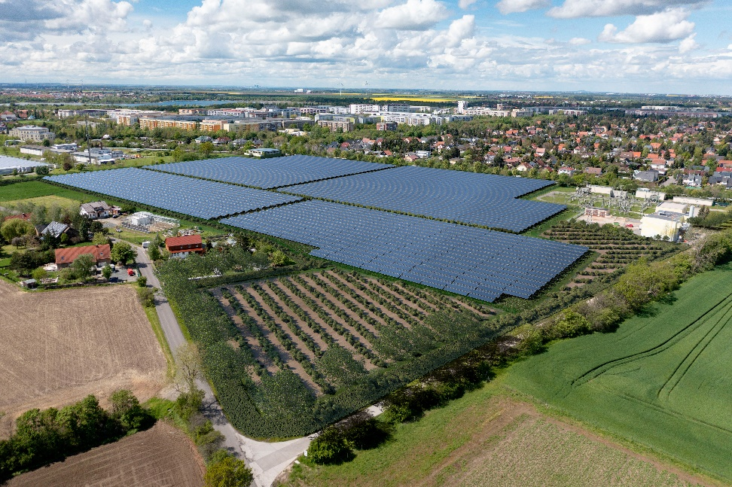
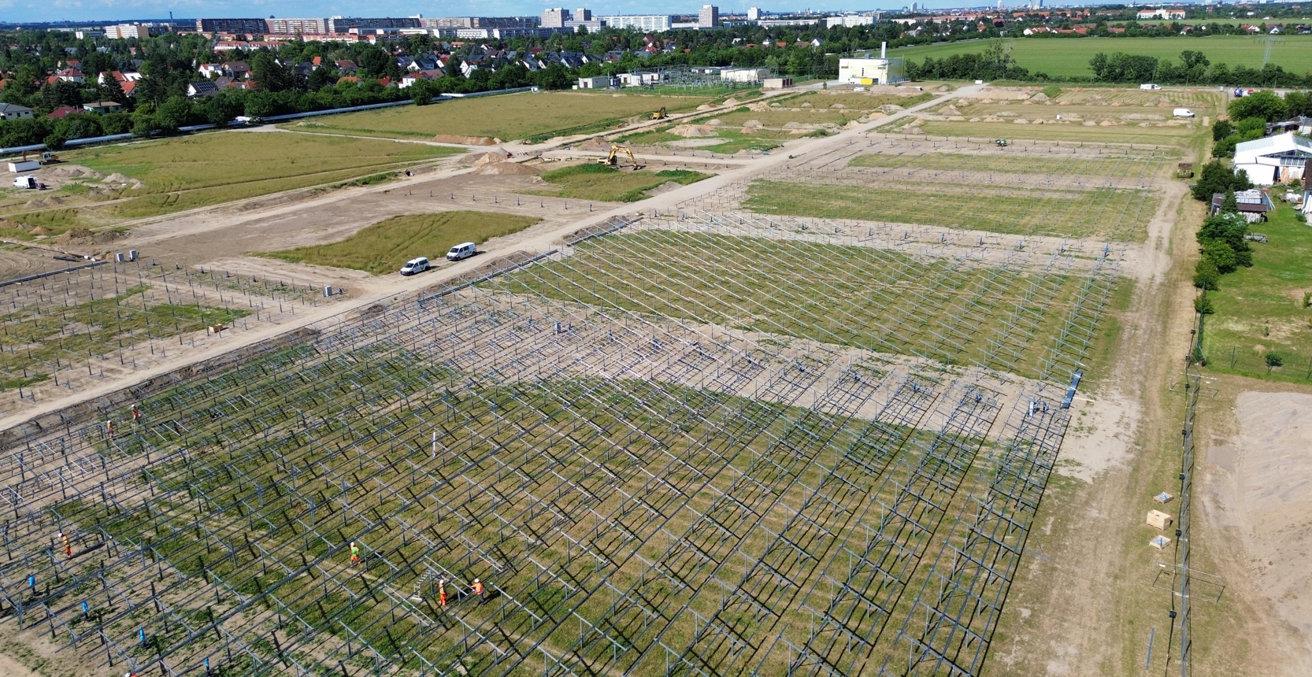
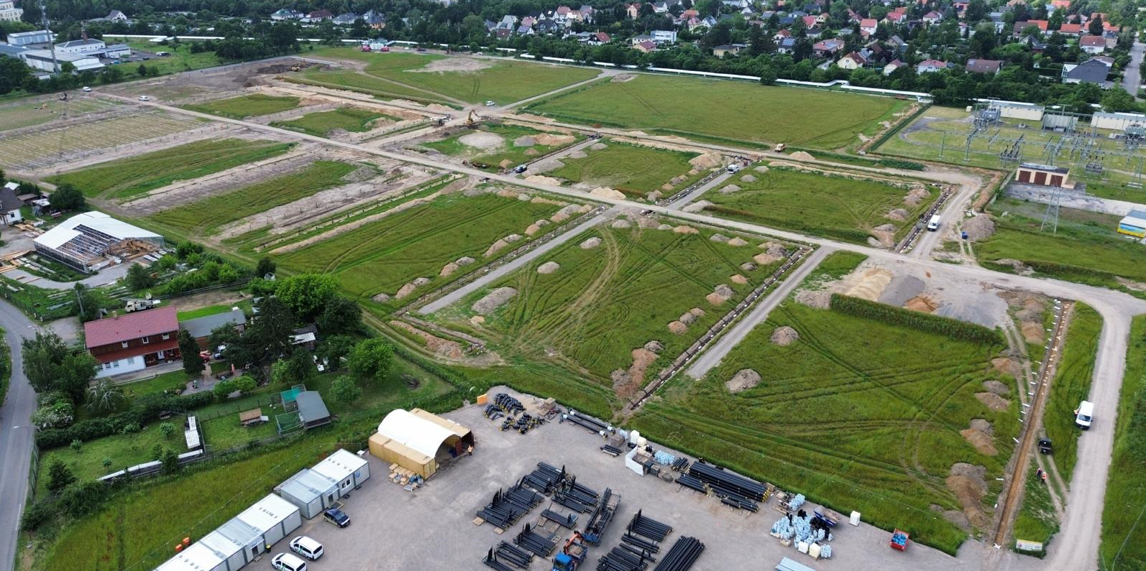
Solar district heating for cities
Municipal utility
City of Leipzig
inhabitants | ~ 588,000 (2019)
Heat demand grid | ~ 1,650 GWh
Commissioning | 2026
Gross collector area | 65,000 m²
Land area | ca. 140,000 m²
Annual energy yield | 25.8 GWh
Solar fraction | 1.6 %
Nominal power | 41 MW
Heat grid temperatures | 103 / 68 °C | 113 / 62 °C
Heat store | Hydraulic separator 100 m³
Feed in type | Decentralized
picture: Stadtwerke Leipzig

Slide 15
Conclusion
Advantages of SDH:
Space efficiency
Cost security
Regional/local added value
Reliable, proven, durable and market-available technology
Challenges:
Scalability
Temperature level
Solar thermal
€
factor: 1
time

Slide 16
ECOLOGICAL.
CONSISTENT.
HEATING.
Dominik Bestenlehner Head of R&D Ritter XL
Phone +49 7157 5359 1412 Mobile +49 173 6211 302 d.bestenlehner@ritter-xl-solar.de
THANK YOU!

